Slide 1

Migration of video learning project
Group Members:
Nusrat Jahan Sumi (1345476)
Mashnunul Huq (1384042)

Slide 2
Content
INTRODUCTION
HTM SPATIAL POOLER
SEQUENCE LEARNING
METHODOLOGY
IMPLEMENTATION OF ALGORITHM
CONCLUSION
REFERENCE

Slide 3
INTRODUCTION
Hierarchical temporal memory(HTM) is a theoretical framework that represents several structural and algorithmic properties of the neocortex.
The HTM algorithm is designed with supervised or unsupervised learning data.
The algorithm learns with the help of a hierarchical network and a continuous stream of input data.
The success of HTM depends on the use of sparse distributed representations(SDRs)

Slide 4
HTM SPATIAL POOLER
Spatial pooler plays a vital role in HTM networks.
In an end-to-end HTM system, the SP transforms input patterns into SDRs in a continuous online fashion.
The HTM temporal memory learns temporal sequences of these SDRs and do the predictions for future inputs.
Different cells within a mini-column represent this feedforward input in different temporal contexts.

Slide 5
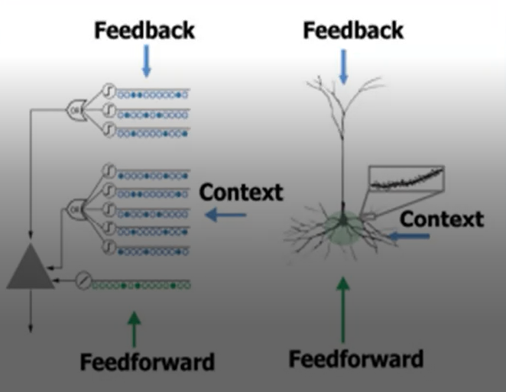
Continue
Cells in a mini-column share the same feedforward classical receptive field.
In this way SP models common receptive field is learned from the input.
The SP output define the activation of mini-columns in response to feedforward inputs.

Slide 6
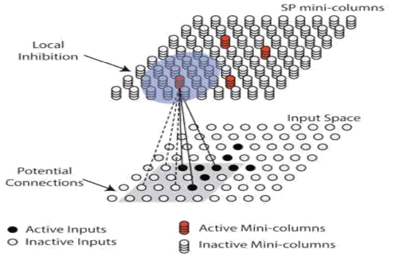
Continue
A signal layer in an HTM network is structured as a set of mini-columns, each mini-columns consist of a set of cells.
Each SP mini-column forms synaptic connections to a population of input neurons.
The dimensionality of the input space depens on the applications.
At any time, only a small fraction of the mini-columns with the most active inputs become active.

Slide 7
SEQUENCE LEARNING
At the time of building intelligent systems to mimic human intelligence and cognition, we must pay serious attention to sequences, including sequence learning as sequential behavior is essential to intelligence.
Learning hierarchical structures help to reduce or eliminate temporal dependencies. It helps to compress the description or sequences.
Cortical Learning Algorithms(CLA) is inspired from the neocortex can mimic the procedure of human brain how to achieve pattern recognition and make intelligent predictions.

Slide 8
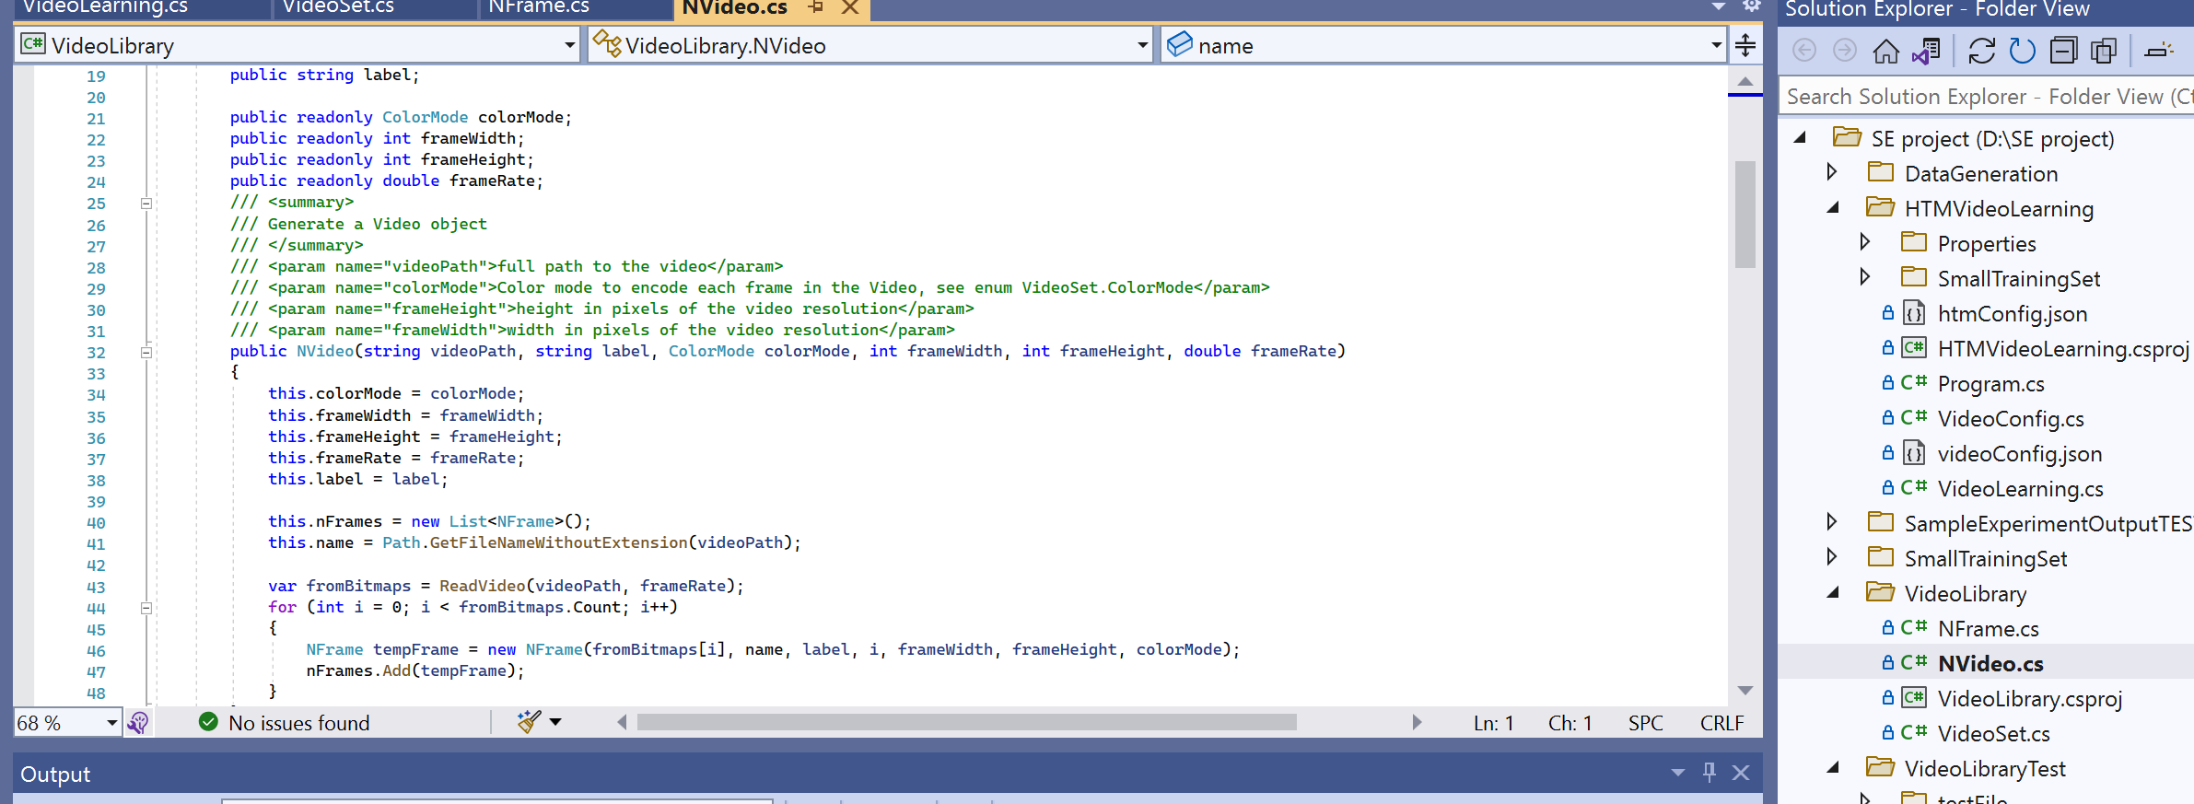
Coding Contribution…
Presenter name

Slide 9
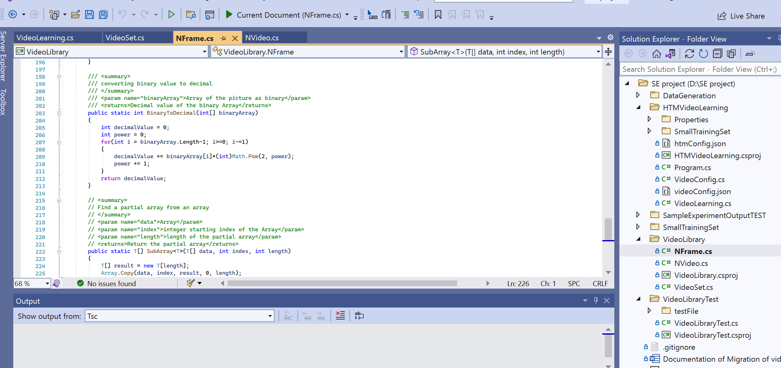
Presentation title
Presenter name

Slide 10
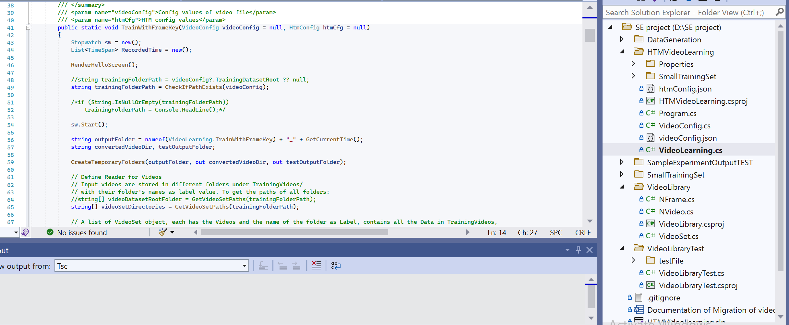
Presentation title
Presenter name

Slide 11
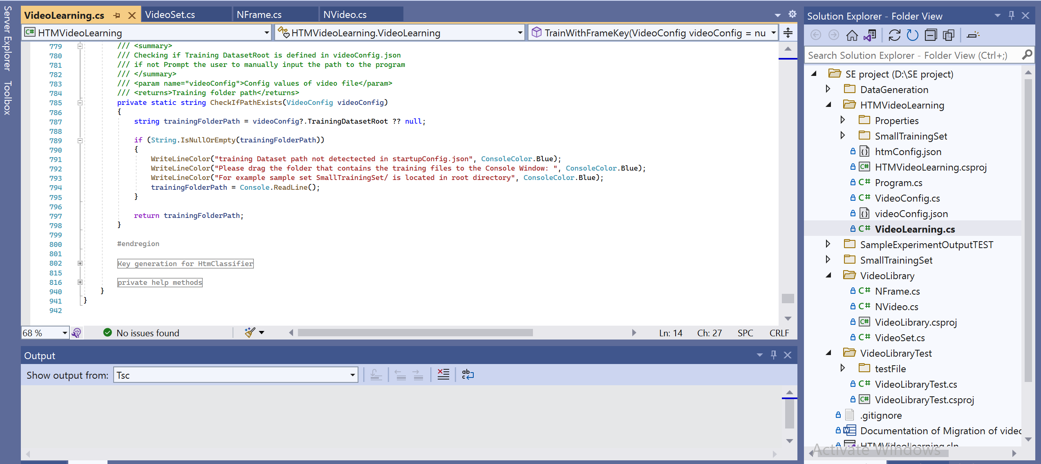
Presentation title
Presenter name

Slide 12
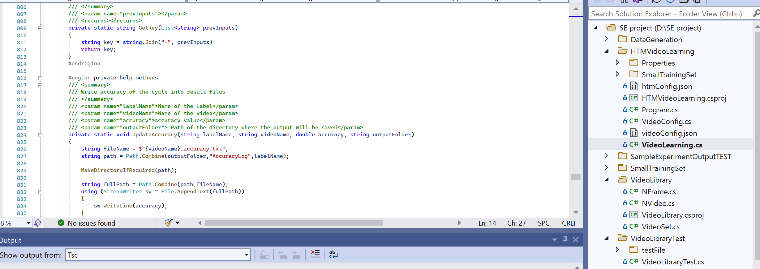
Presentation title
Presenter name

Slide 13
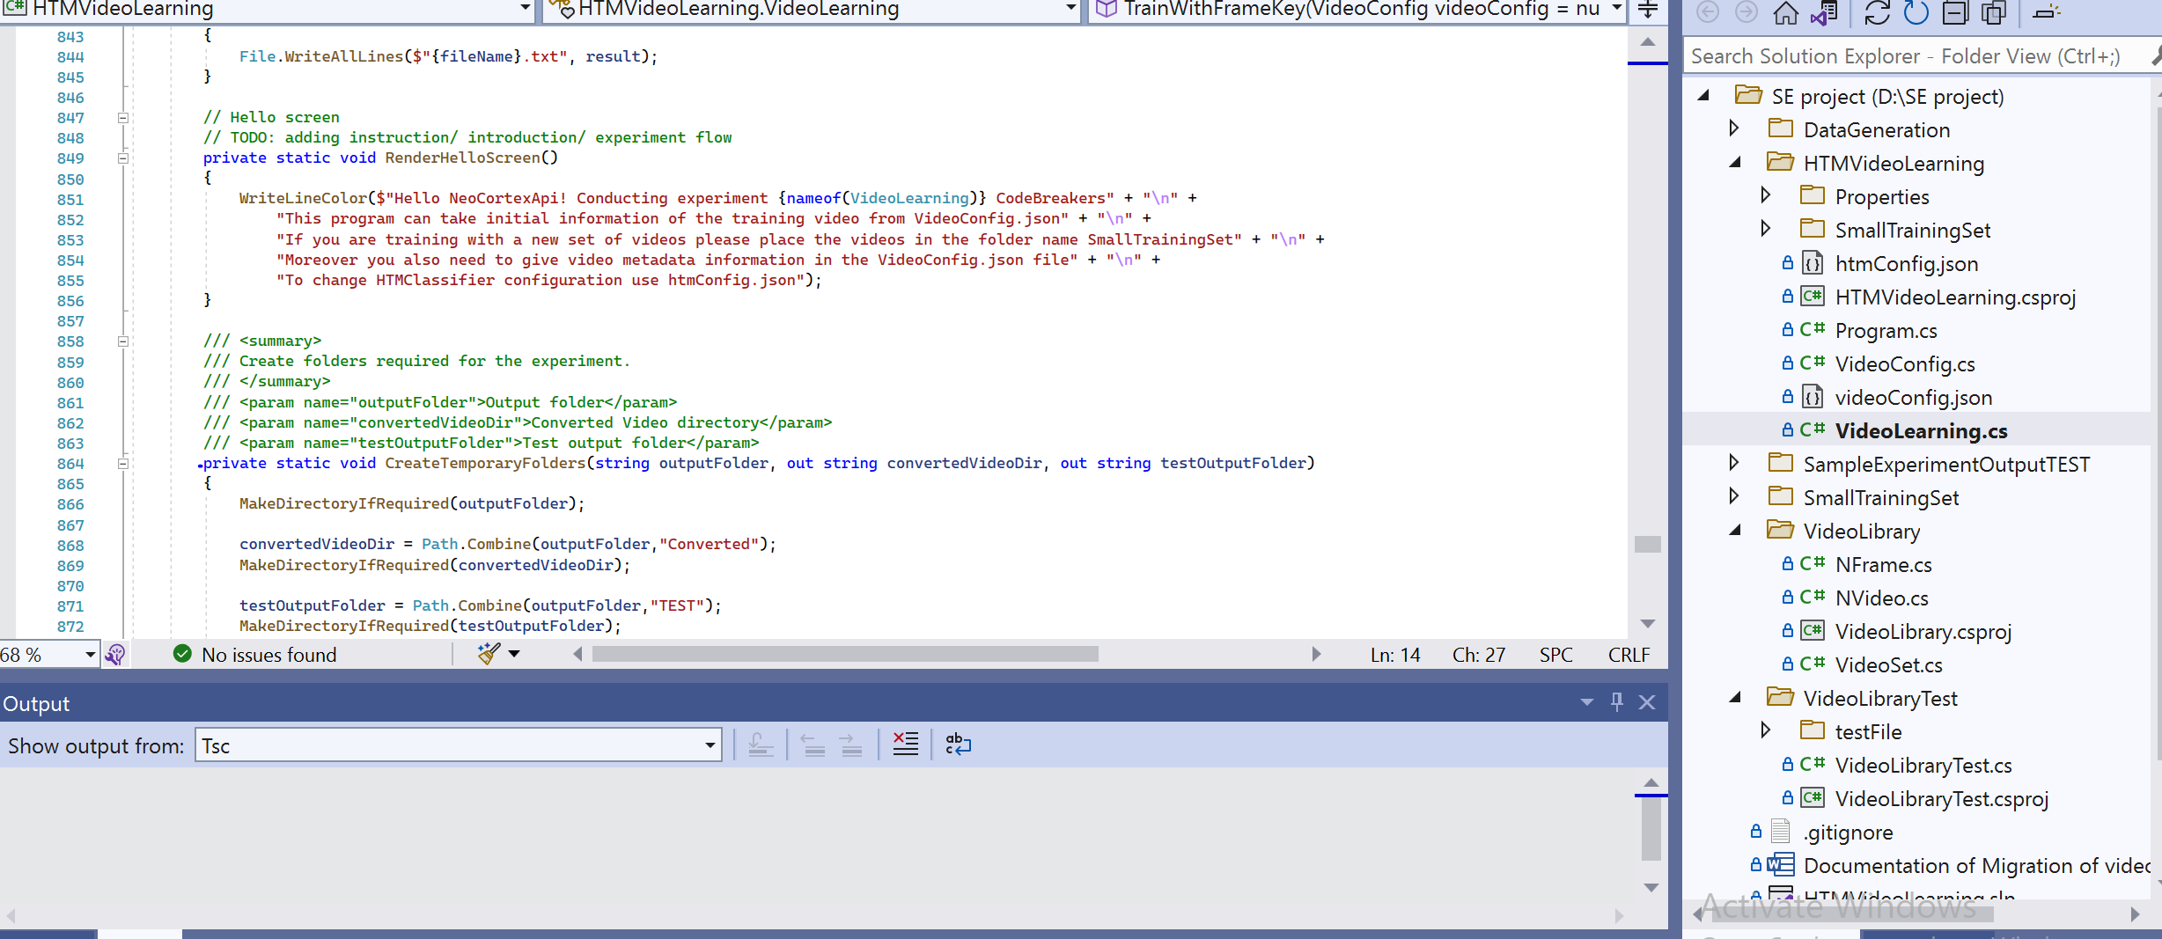
Presentation title
Presenter name

Slide 14
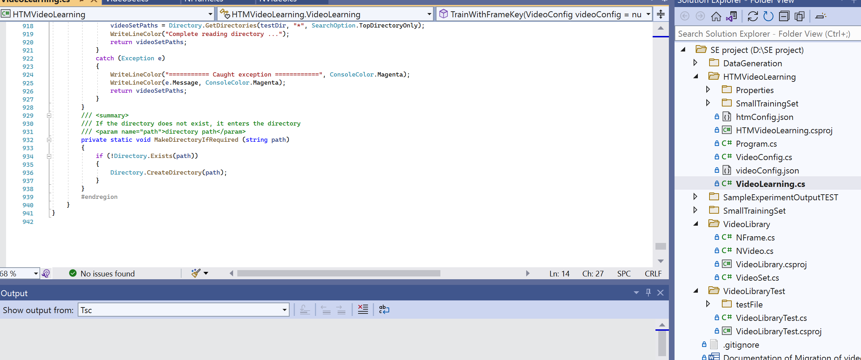
Presentation title
Presenter name

Slide 15
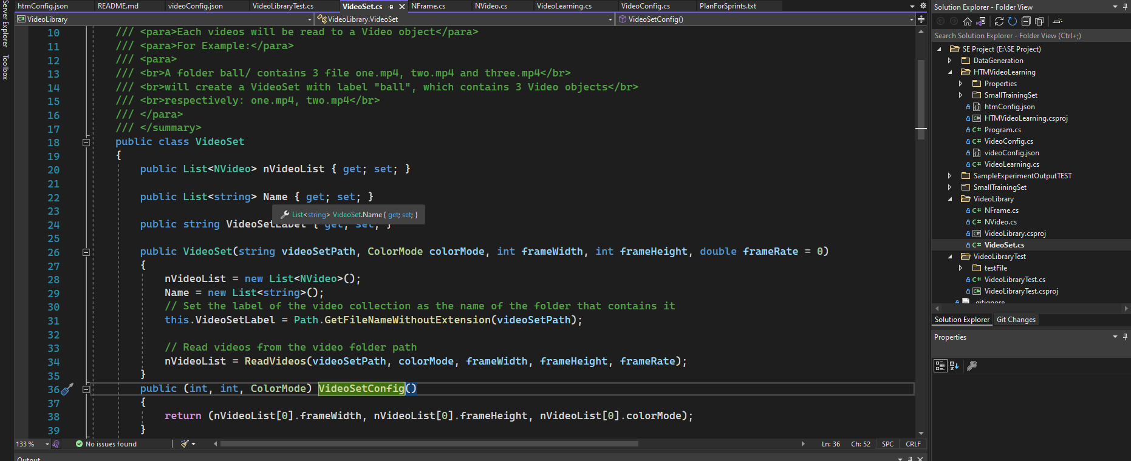
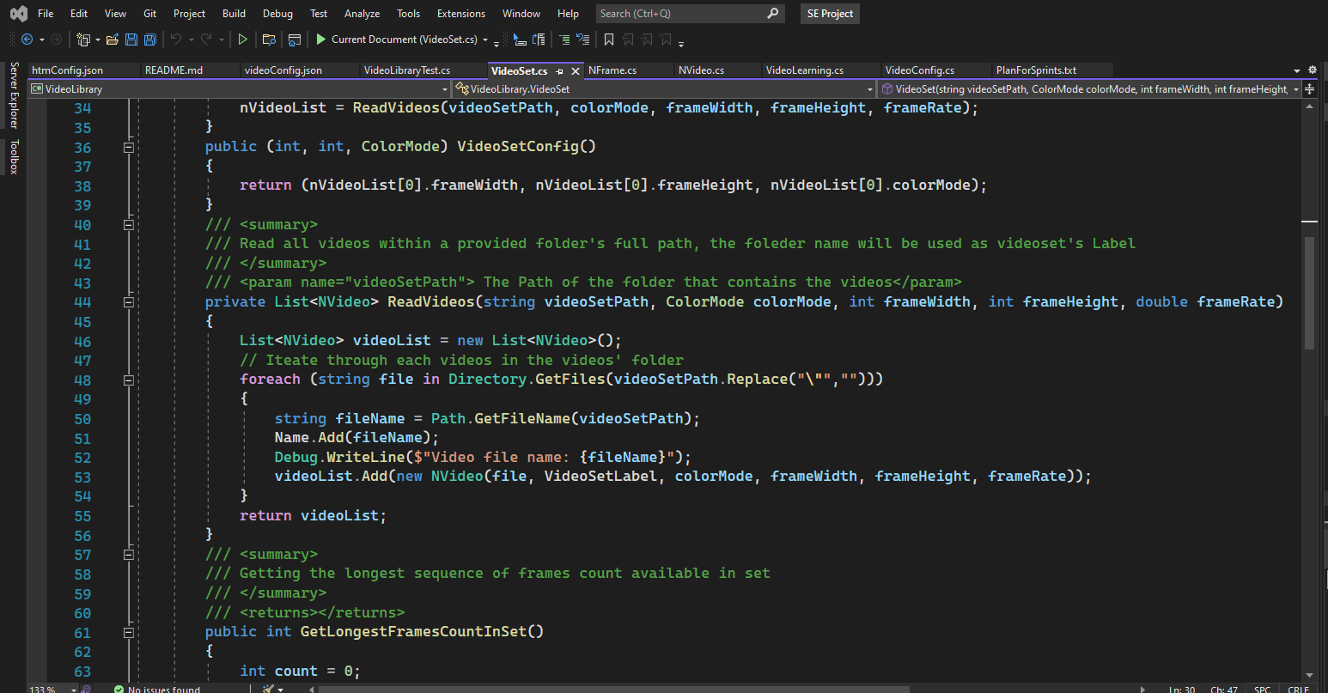
METHODOLOGY

Slide 16
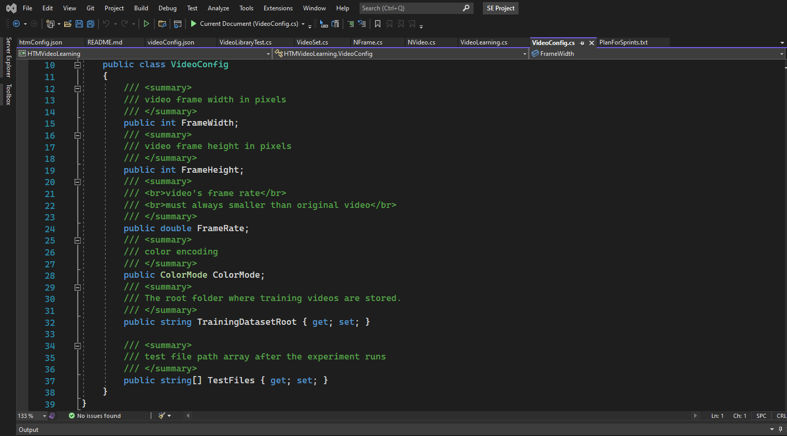
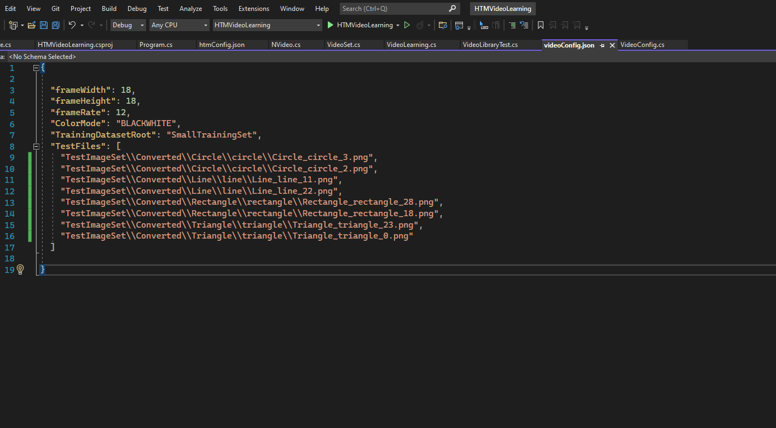
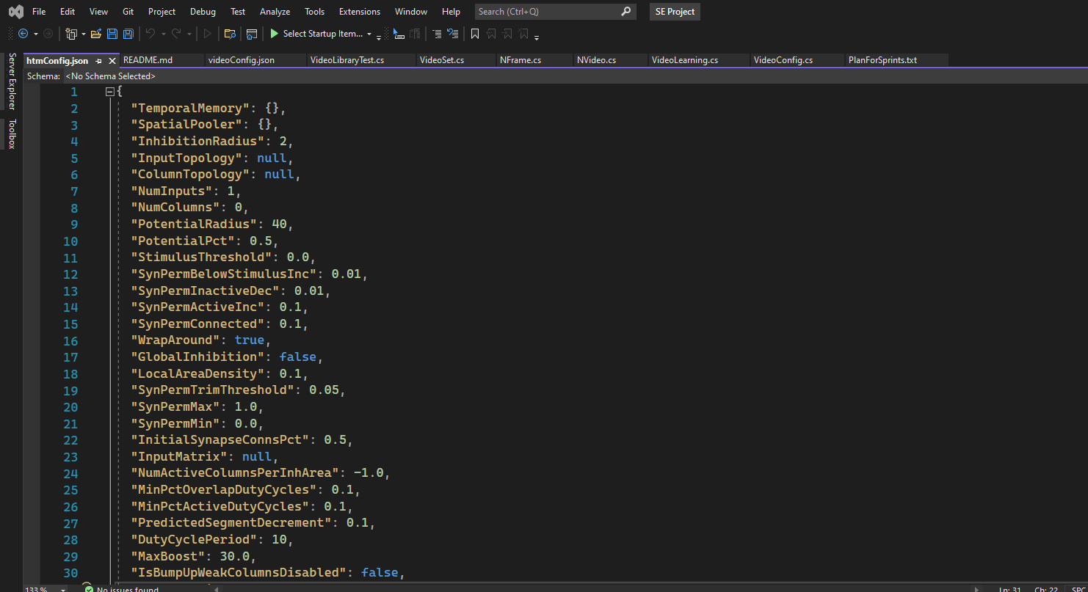
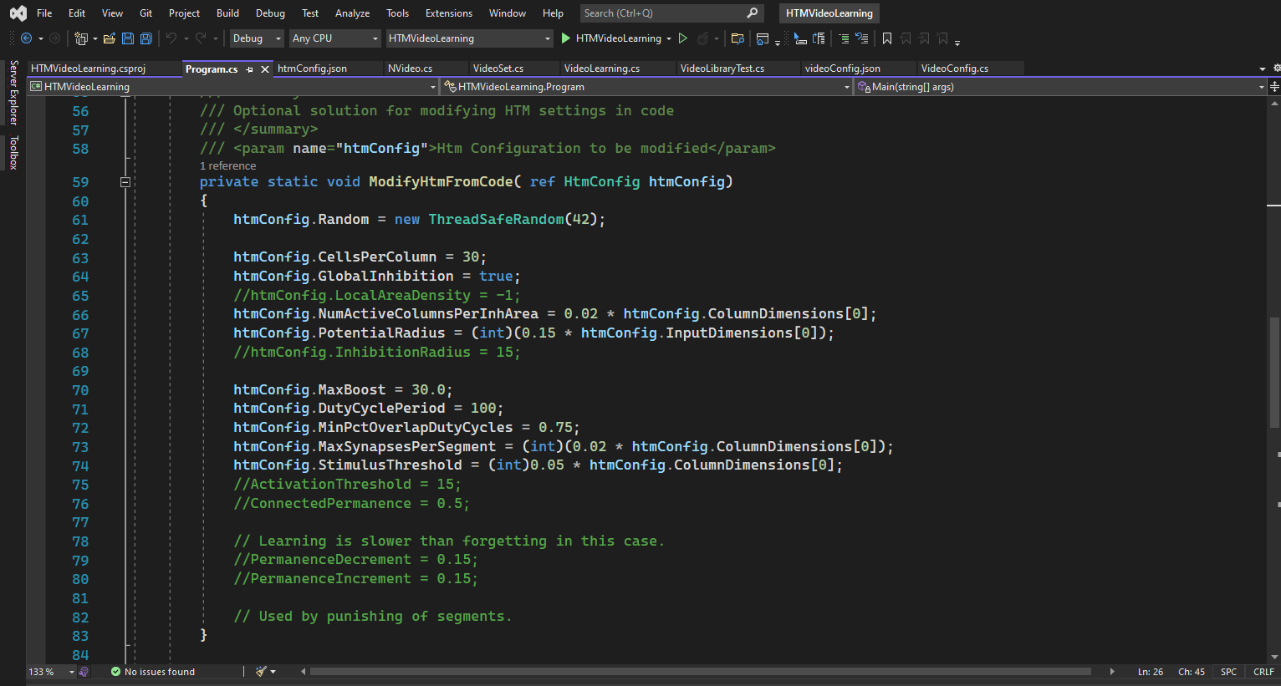
Continue

Slide 17
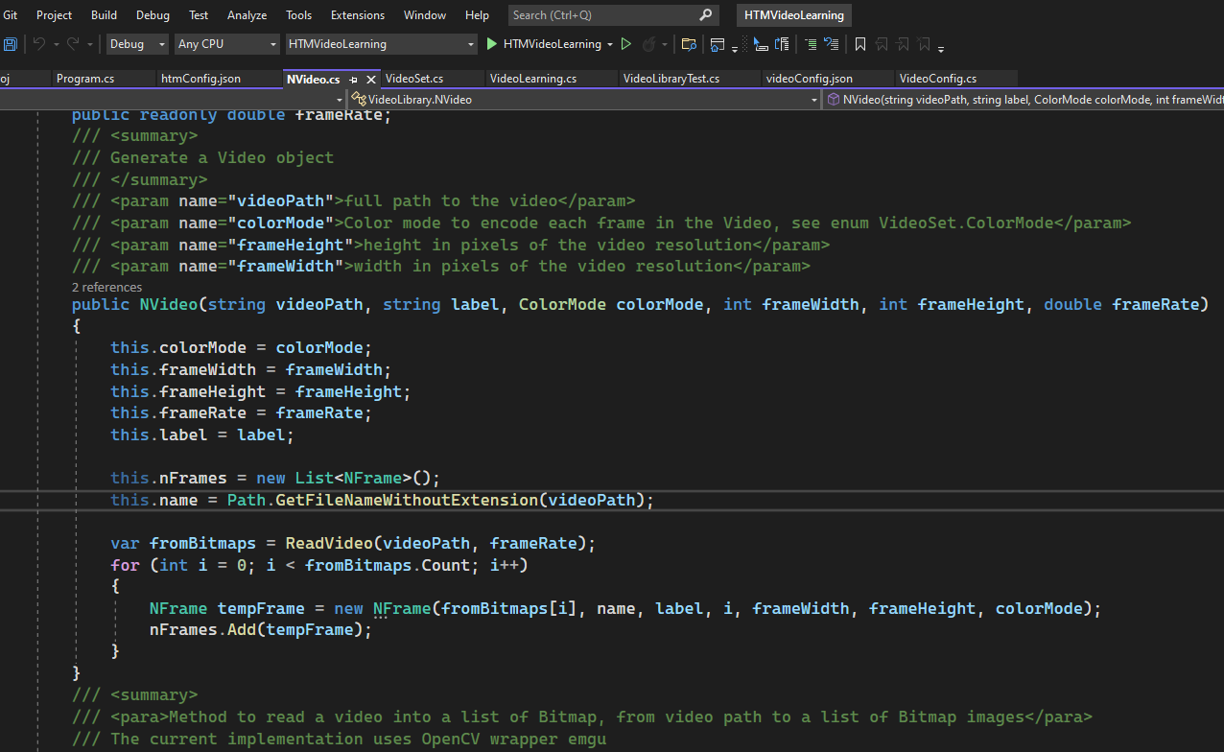
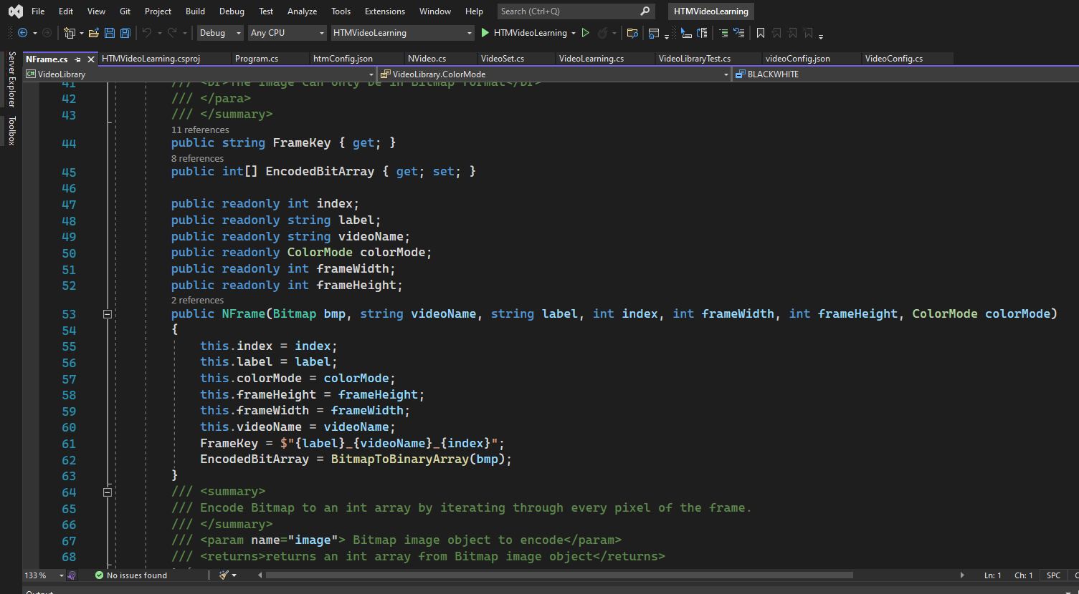
Continue

Slide 18
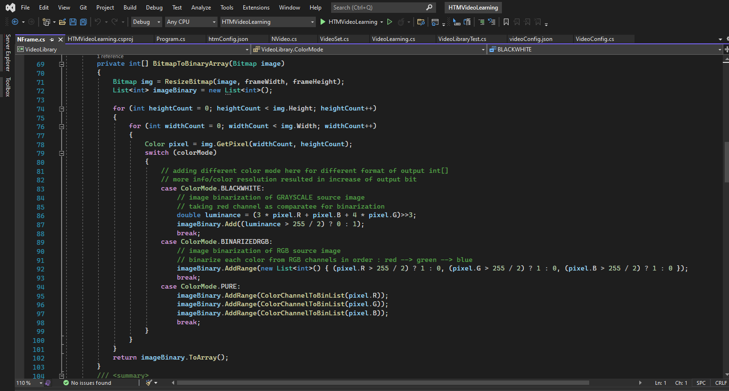
Continue

Slide 19
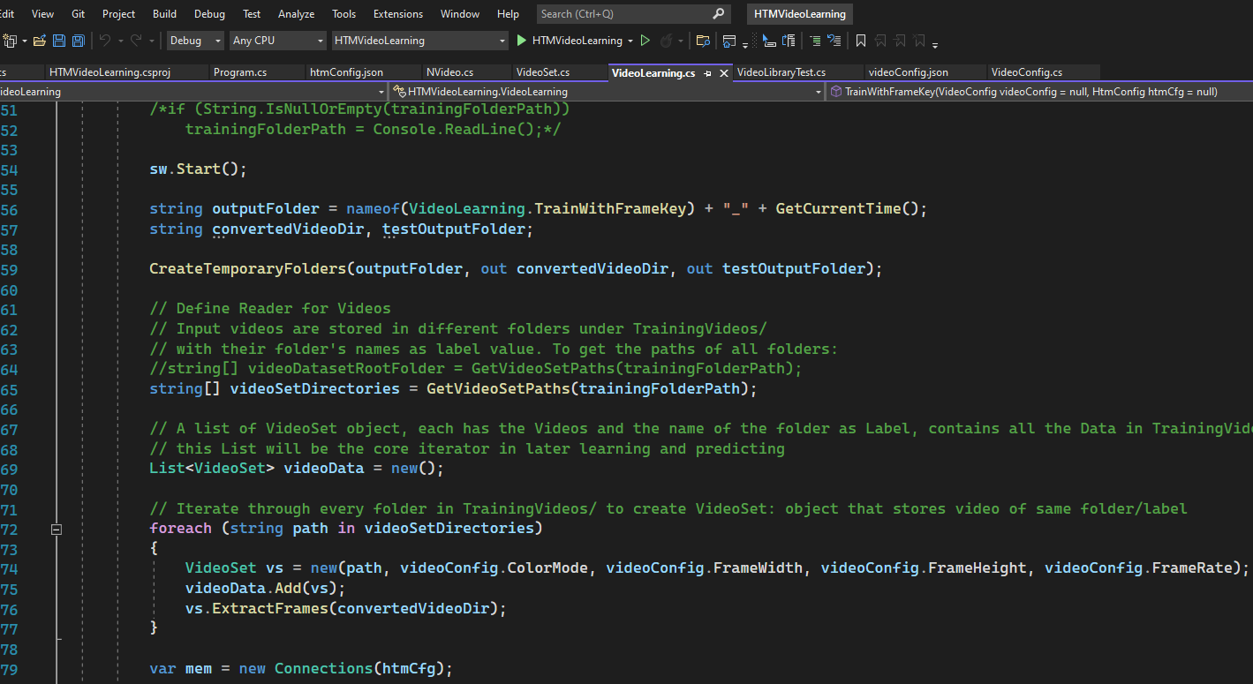
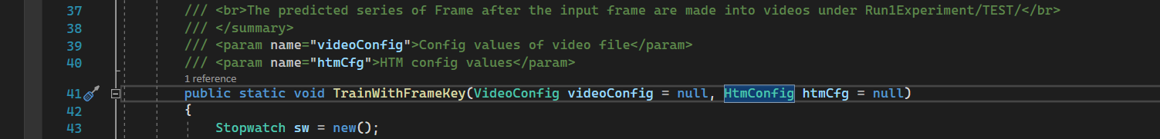
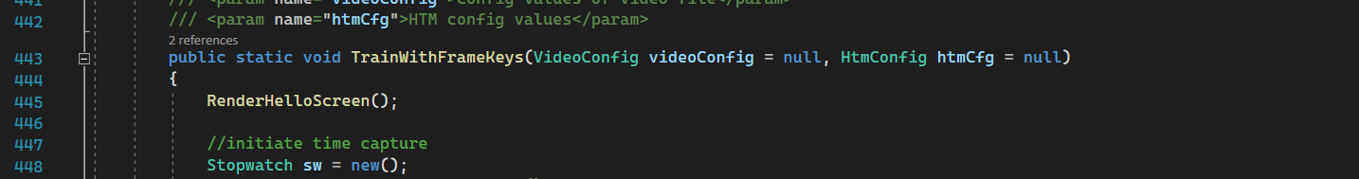
Continue

Slide 20
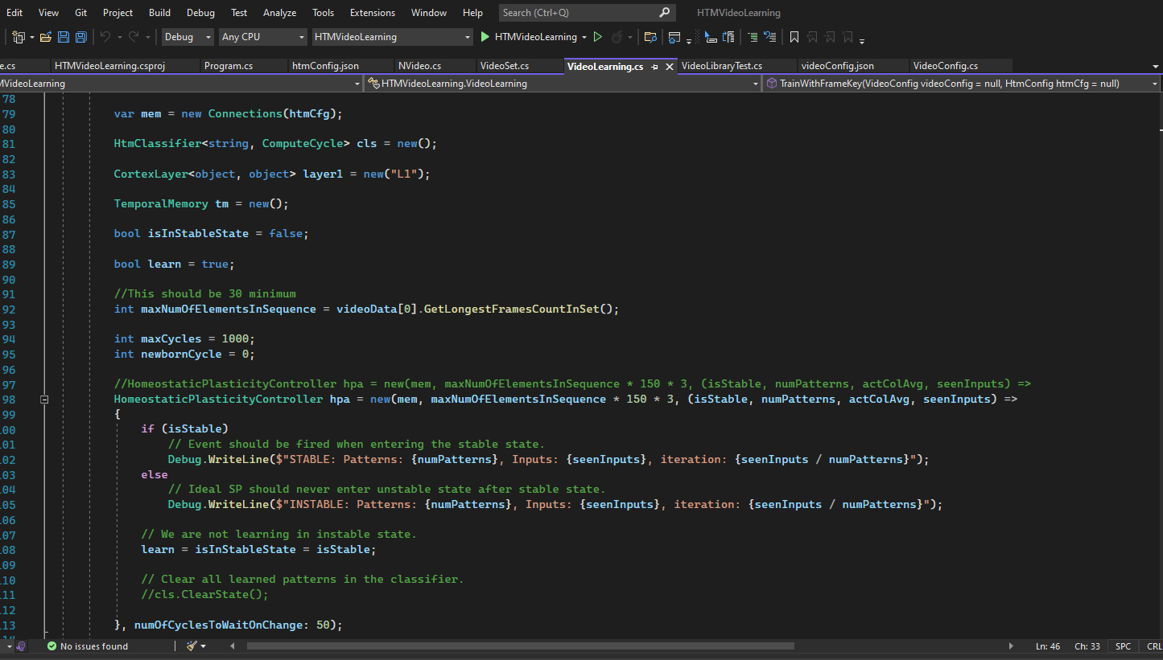
Continue

Slide 21
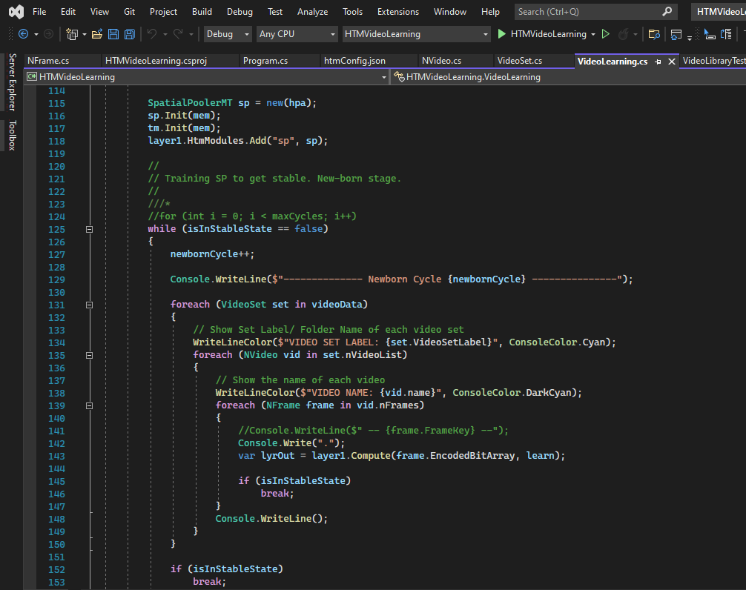
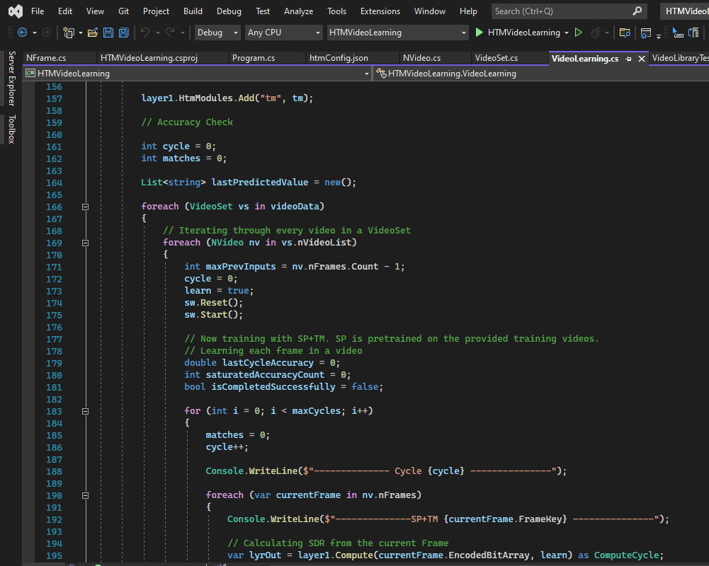
Continue

Slide 22
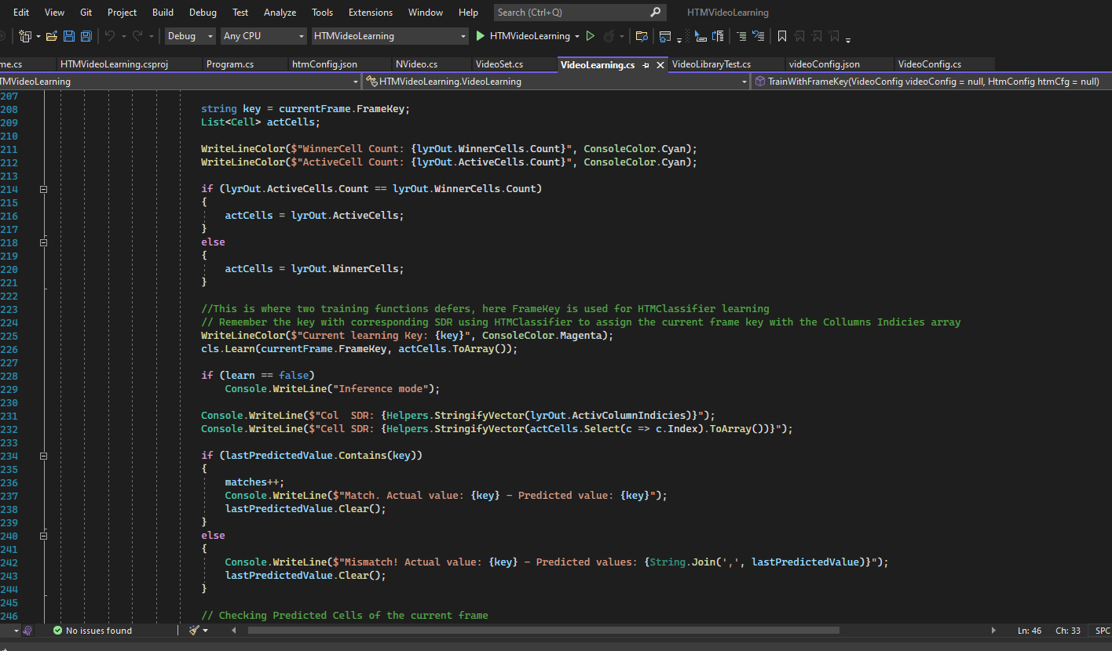
Continue

Slide 23
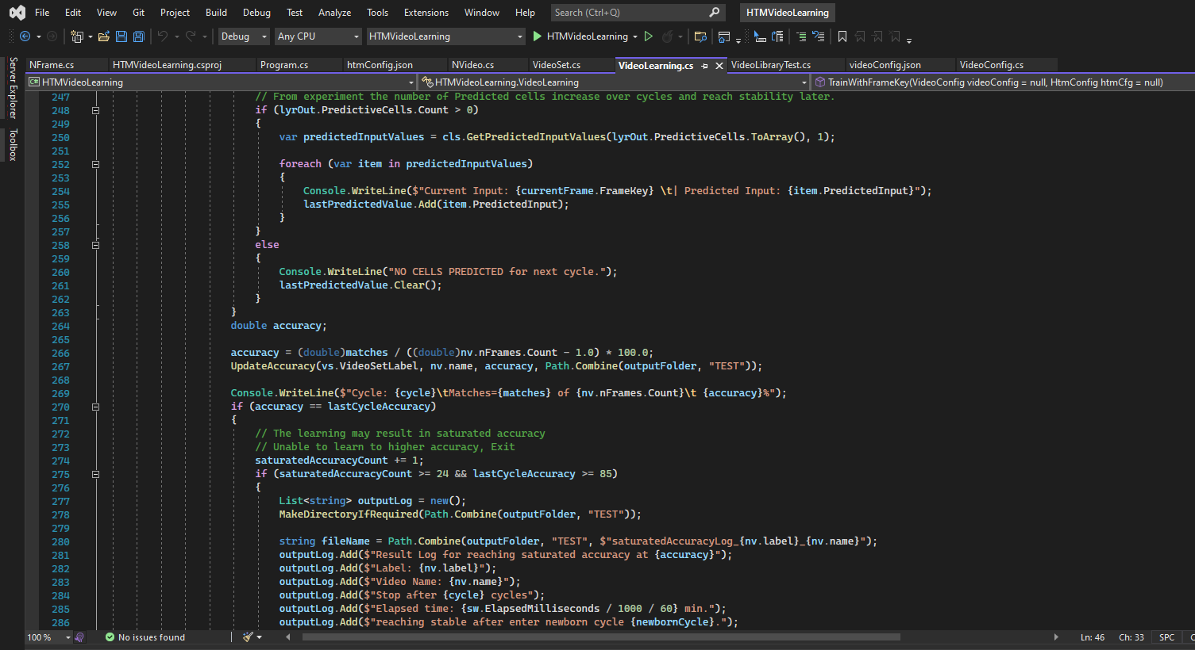
Continue

Slide 24
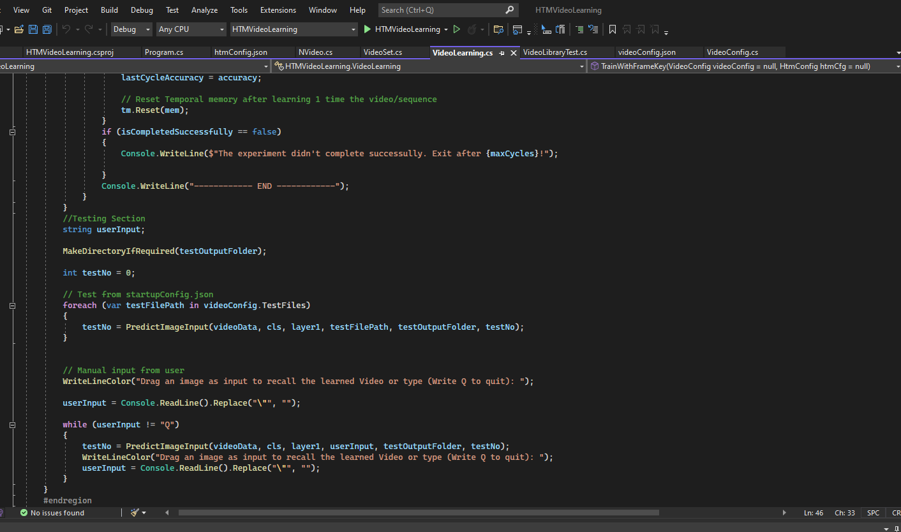
Continue

Slide 25
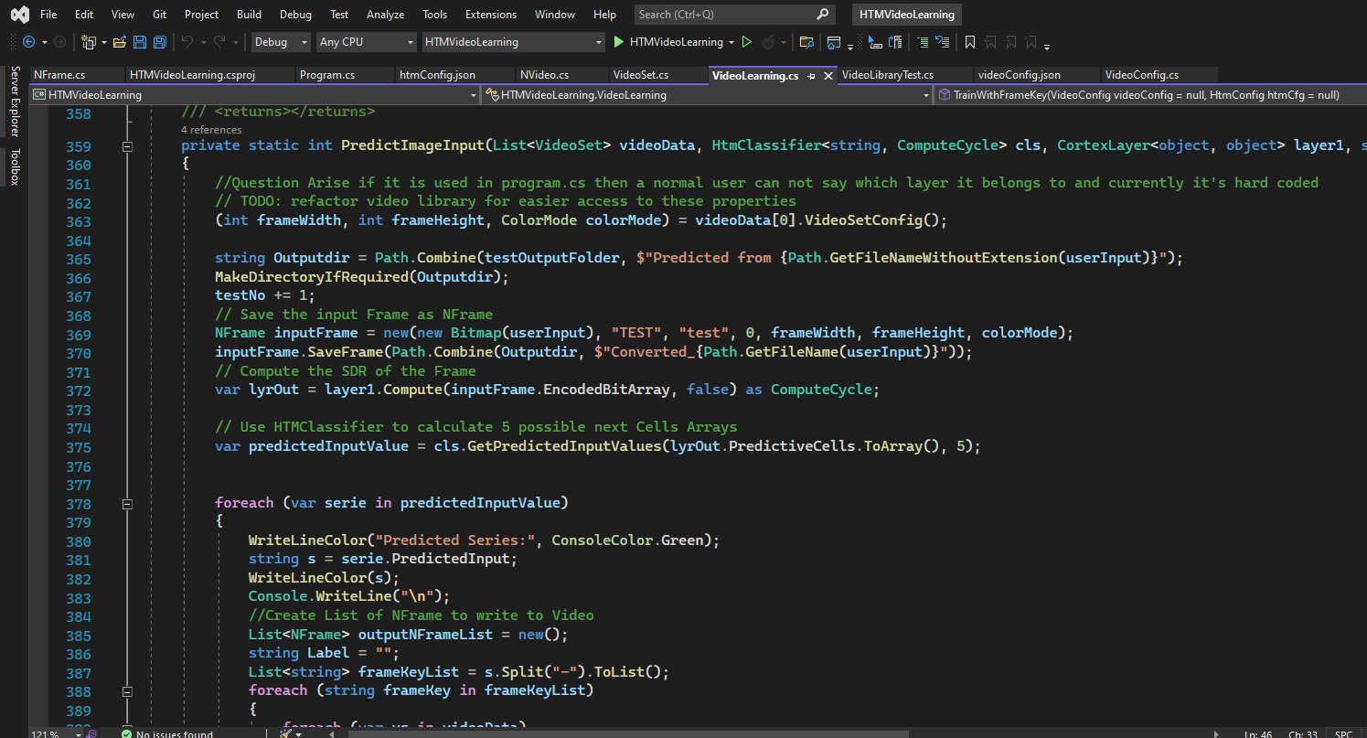
Continue

Slide 26
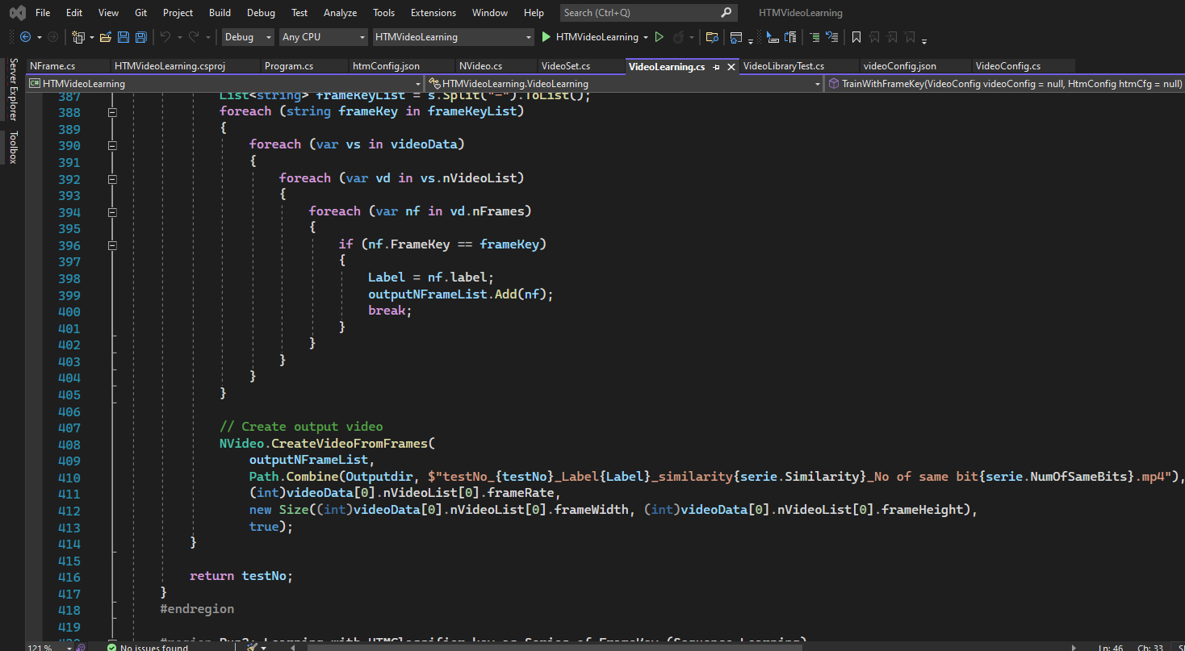
Continue

Slide 27
IMPLEMENTATION OF ALGORITHM
Pseudo Code:
Define and Read Video configuration and HTM configuration from videoConfig.json and htmConfig.json
Define the output folder and test output folder, if necessary make temporaryfolder
Read from every video and save the encoded frames in converted video directory
Instantiate HomeostaticPlasticityController with htm configuration set above
Until reaching stable state learn with the encoded frame creating SDR from SP and TM
Run through each video’s each frame and for sequential learning learn with one framekey
or for multisequence learning learn with 3 frames
Predict 1 possible next frame for the current frame in sequence learning
Or predict 1 frame from 3 possible next frames for it in multisequence learning
Check if the predicted frame matches with the current frame, if it matches increase matched frame count
Calculate the accuracy for the current video set
If the accuracy reaches to saturation for 24(for sequential) or 10(for multisequence) record the accuracy
with iteration numbers
Try to predict frames for the test files given in the videoConfig.json and make the video file with predicted frames
Take image input from user and predict frames and make the video file with predicted frames
Terminate when user inputs “Q”

Slide 28
CONCLUSION
Data Type | Highest Accuracy | Saturated Accuracy
Circle | 102.857% Stability reached at 185th newborn cycle | 102.85714285% Saturation level fixed at 117th cycle
Line | 100% Stability reached at 185th newborn cycle | 95.74468085% Saturation level fixed at 447th cycle
Rectangle | 100% Stability reached at 185th newborn cycle | 100% Saturation level fixed at 144th cycle
Triangle | 100% Stability reached at 185th newborn cycle | 100% Saturation level fixed at 127th cycle
Data Type | Highest Accuracy | Saturated Accuracy
Circle | 102.857% Stability reached at 177th newborn cycle | 102.8571428% Saturation level fixed at 69th cycle
Line | 97.87% Stability reached at 177th newborn cycle | 97.8723404% Saturation level fixed at 217th cycle
Rectangle | 100% Stability reached at 177th newborn cycle | 97.1428571% Saturation level fixed at 77th cycle
Triangle | 100% Stability reached at 177th newborn cycle | 100% Saturation level fixed at 17th cycle
Limitations
The prediction for user input image is given mostly from the last learned video set
Better video codec format should be implemented
Drawing from encoded bit array should be better and OS independent like SkiaSharp Library

Slide 29
REFERENCE
Boudreau, L. G. (2018, 5). Rochester Institute of TechnologyRochester Institute. Retrieved from RIT Scholar Works: https://scholarworks.rit.edu/cgi/viewcontent.cgi?article=10897&context=theses
Dobrick, D. (2021). Improved HTM Spatial Pooler with. Retrieved from University of Plymouth: https://pearl.plymouth.ac.uk/bitstream/handle/10026.1/17130/Improved%20HTM%20spatial%20pooler%20with%20homeostatic%20plasticity%20control.pdf?sequence=1&isAllowed=y
Hawkins, S. &. (2017, 10 17). A Theory of How Columns in the Neocortex Enable Learning the Structure of the World. Retrieved from https://frontiersin.org/articles/10.3389/fncir.2017.0008
Lipton, Z. C., & Berkowitz, J. (2015). A Critical Review of Recurrent Neural Networks, 2-4.

